Slide 1

Wine Quality
Analysis

Slide 2
Problem
In industries, understanding the demand of wine quality testing can be a complex task for the laboratory with numerous analysts and residues to monitor. But our application’s prediction provides ideal solution for the analysis of wine which will make this whole process efficient and cheaper with less human interaction.

Slide 3
Data description
Fixed acidity Total so2
Volatile acidity Density
Citric acid pH
Residual sugar Sulphate
Chlorides Alcohol
Free so2 Quality

Slide 4
Data set
Sr. No. | Fixed acidity | Volatile acidity | Citric acid | Residual sugar | chloride | Free sulfur dioxide | Total sulfur dioxide | Density | PH | Sulphate | Alcohol | Quality
1 | 7.4 | 0.7 | 0 | 1.9 | 0.076 | 11 | 34 | 0.9978 | 3.51 | 0.56 | 9.4 | 5
2 | 7.8 | 0.88 | 0 | 2.6 | 0.098 | 25 | 67 | 0.9968 | 3.2 | 0.68 | 9.8 | 5
3 | 7.8 | 0.76 | 0.04 | 2.3 | 0.092 | 15 | 54 | 0.997 | 3.26 | 0.65 | 9.8 | 5
4 | 11.2 | 0.28 | 0.56 | 1.9 | 0.075 | 17 | 60 | 0.998 | 3.16 | 0.58 | 9.8 | 6
5 | 7.4 | 0.7 | 0 | 1.9 | 0.076 | 11 | 34 | 0.9978 | 3.51 | 0.56 | 9.4 | 5
6 | 7.4 | 0.66 | 0 | 1.8 | 0.075 | 13 | 40 | 0.9978 | 3.51 | 0.56 | 9.4 | 5
7 | 7.9 | 0.6 | 0.06 | 1.6 | 0.069 | 15 | 59 | 0.9964 | 3.3 | 0.46 | 9.4 | 5
8 | 7.3 | 0.65 | 0 | 1.2 | 0.065 | 15 | 21 | 0.9946 | 3.39 | 0.47 | 10 | 7
9 | 7.8 | 0.58 | 0.02 | 2 | 0.073 | 9 | 18 | 0.9968 | 3.36 | 0.57 | 9.5 | 7
10 | 7.5 | 0.5 | 0.36 | 6.1 | 0.071 | 17 | 102 | 0.9978 | 3.35 | 0.8 | 10.5 | 5
11 | 6.7 | 0.58 | 0.08 | 1.8 | 0.097 | 15 | 65 | 0.9959 | 3.28 | 0.54 | 9.2 | 5
12 | 7.5 | 0.5 | 0.36 | 6.1 | 0.071 | 17 | 102 | 0.9978 | 3.35 | 0.8 | 10.5 | 5

Slide 5
Data Analysis
Descriptive statistics
Correlation matrix
Fitting of Regression model
Fitting of Logistic regression
Subset the data based on good quality [5,6,7,8,9] and poor quality [3,4].

Slide 6
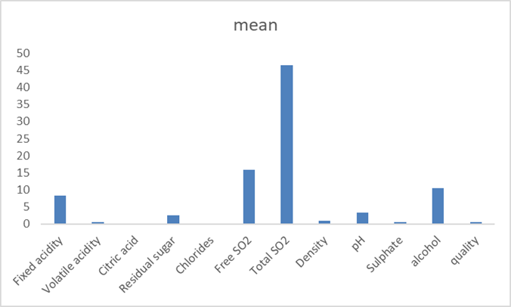
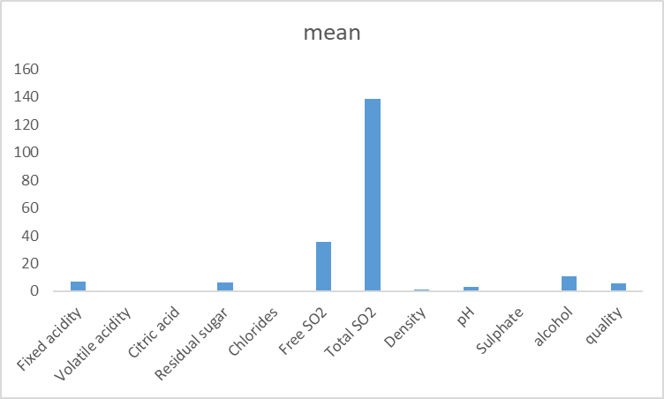
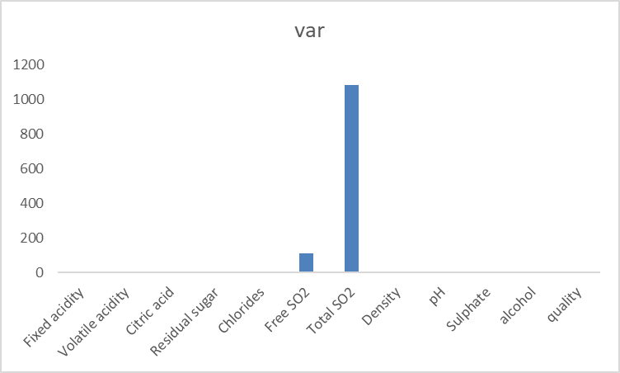
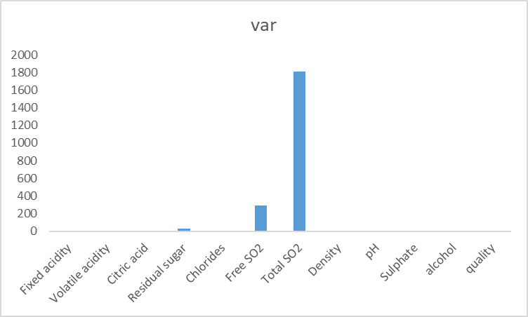
Graphical representation of Descriptive statistics
Red wine
White wine

Slide 7
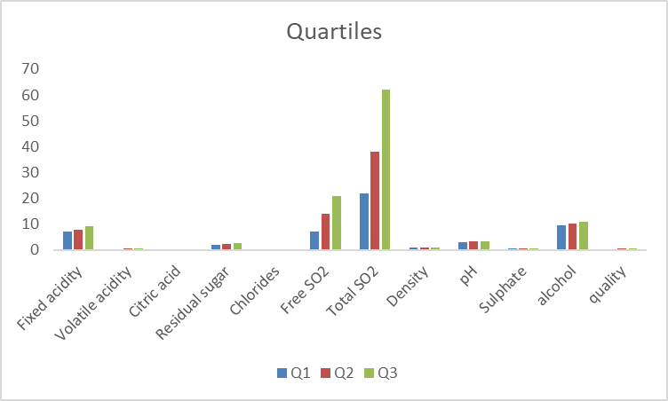
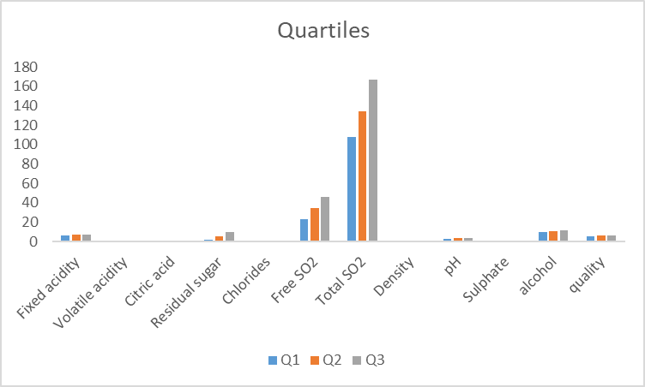
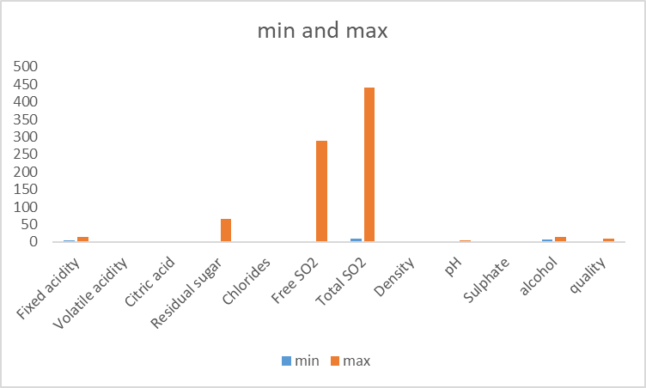
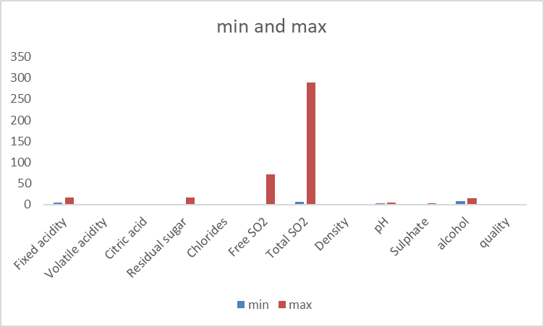

Slide 8
Correlation
Free SO2 and total SO2 are highly correlated but do not with any other variable in both data sets.
Alcohol is highly correlated with quality in both data sets.
For red wine fixed acidity is highly correlated with density and for white wine fixed acidity is highly correlated with citric acid.
For both wine data sets residual sugar and density are highly correlated.

Slide 9
Multiple Regression Analysis
By applying multiple linear regression model , we could not find the required adequate model since it’s R2 adj is smaller than required.
For red wine : Rsq adj = 36.1%
For white wine : Rsq adj = 28%

Slide 10
Logistic Regression Analysis
We tried to fit a logistic regression model. We considered the response variable ‘quality’ as binary variable and fit a logistic regression model .
Case 1): If we considered 3,4,5 as ‘zero’ as poor quality and 6,7,8 as ‘One’ as good quality values.
 | Cal chi sq | Tab chi sq
Red wine | 1655.53 | 1680
White wine | 4932.60 | 5049.73

Slide 11
Case 2): If we considered 3,4 as ‘zero’ as poor quality and 5,6,7,8 as ‘One’ as good quality values.
If we compare the above Logistic models, the second model is more adequate than first.
 | Cal chi sq | Tab chi sq
Red wine | 431.29 | 1680
White wine | 1296.5 | 5049.73

